Slide 1
An Introduction to the Multichannel Rendezvous Problem-Part VI
Prof. Cheng-Shang Chang (張正尚教授)
Institute of Communications Engineering National Tsing Hua University
July 2025

Slide 2
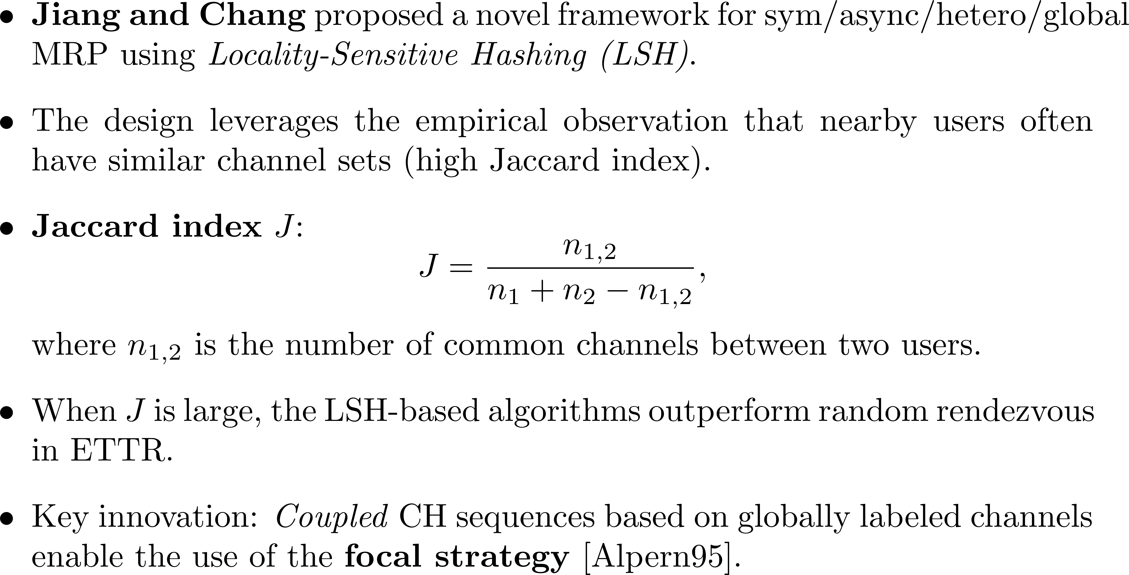
Consistent channel hopping algorithms
Can we do better?

Slide 3
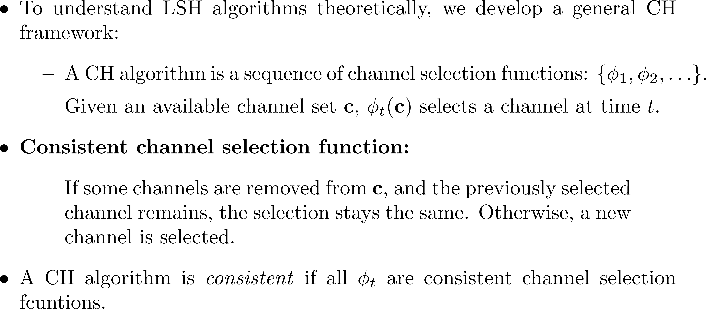
Consistent channel hopping algorithms
From sequence-based to function-based CH algorithms
Y. Liu, Y.-C. Cheng, and C.-S. Chang, “Consistent channel hopping algorithms for the multichannel rendezvous problem with heterogeneous available channel sets,” arXiv preprint arXiv:2506.18381, 2025.

Slide 4
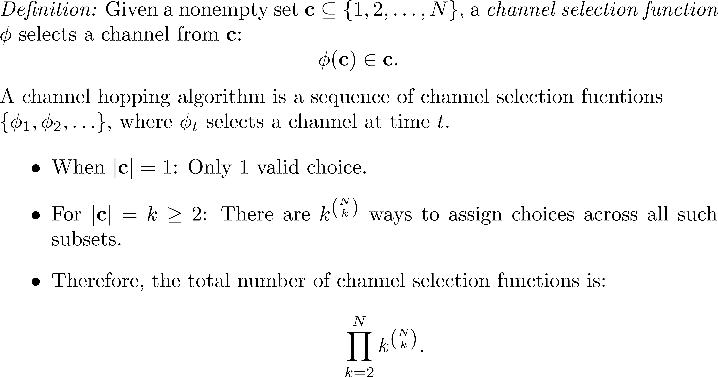
Channel selection functions and their enumeration

Slide 5
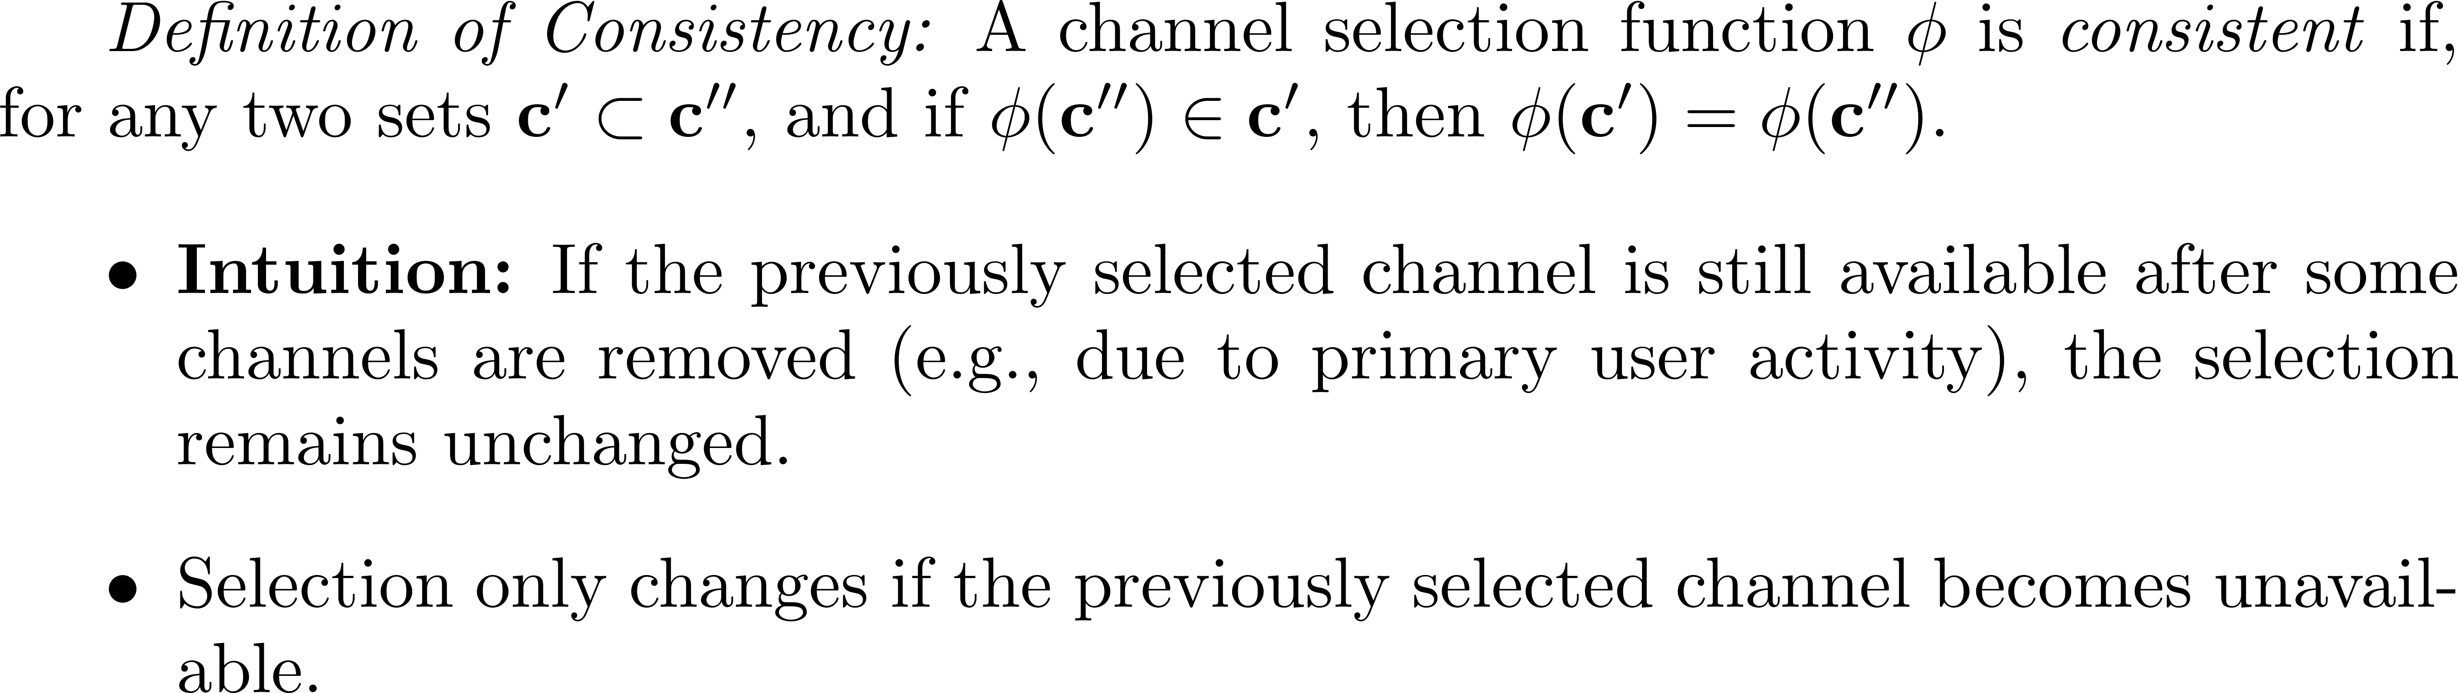









Consistent channel selection functions (CCSF)
$1$
$7$
$2$
$6$
$φ\left( \right)=4$
$=φ\left( \right)$
$$5$$
$4$
$3$

Slide 6
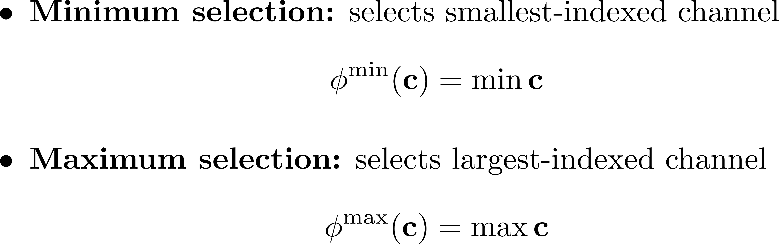







Examples of consistent channel selection functions
$6$
$7$
$2$
$1$
$$5$$
$4$
$3$
6

Slide 7
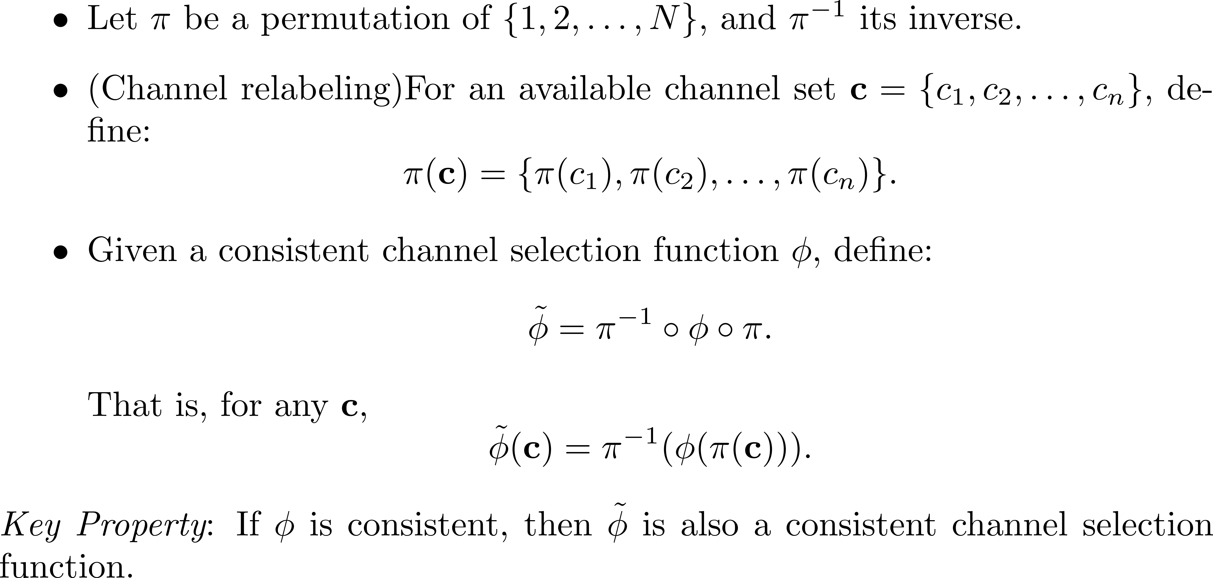
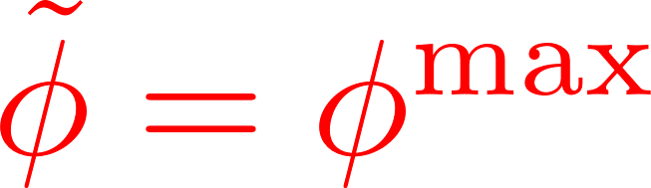
Consistency is preserved through channel relabeling

Slide 8
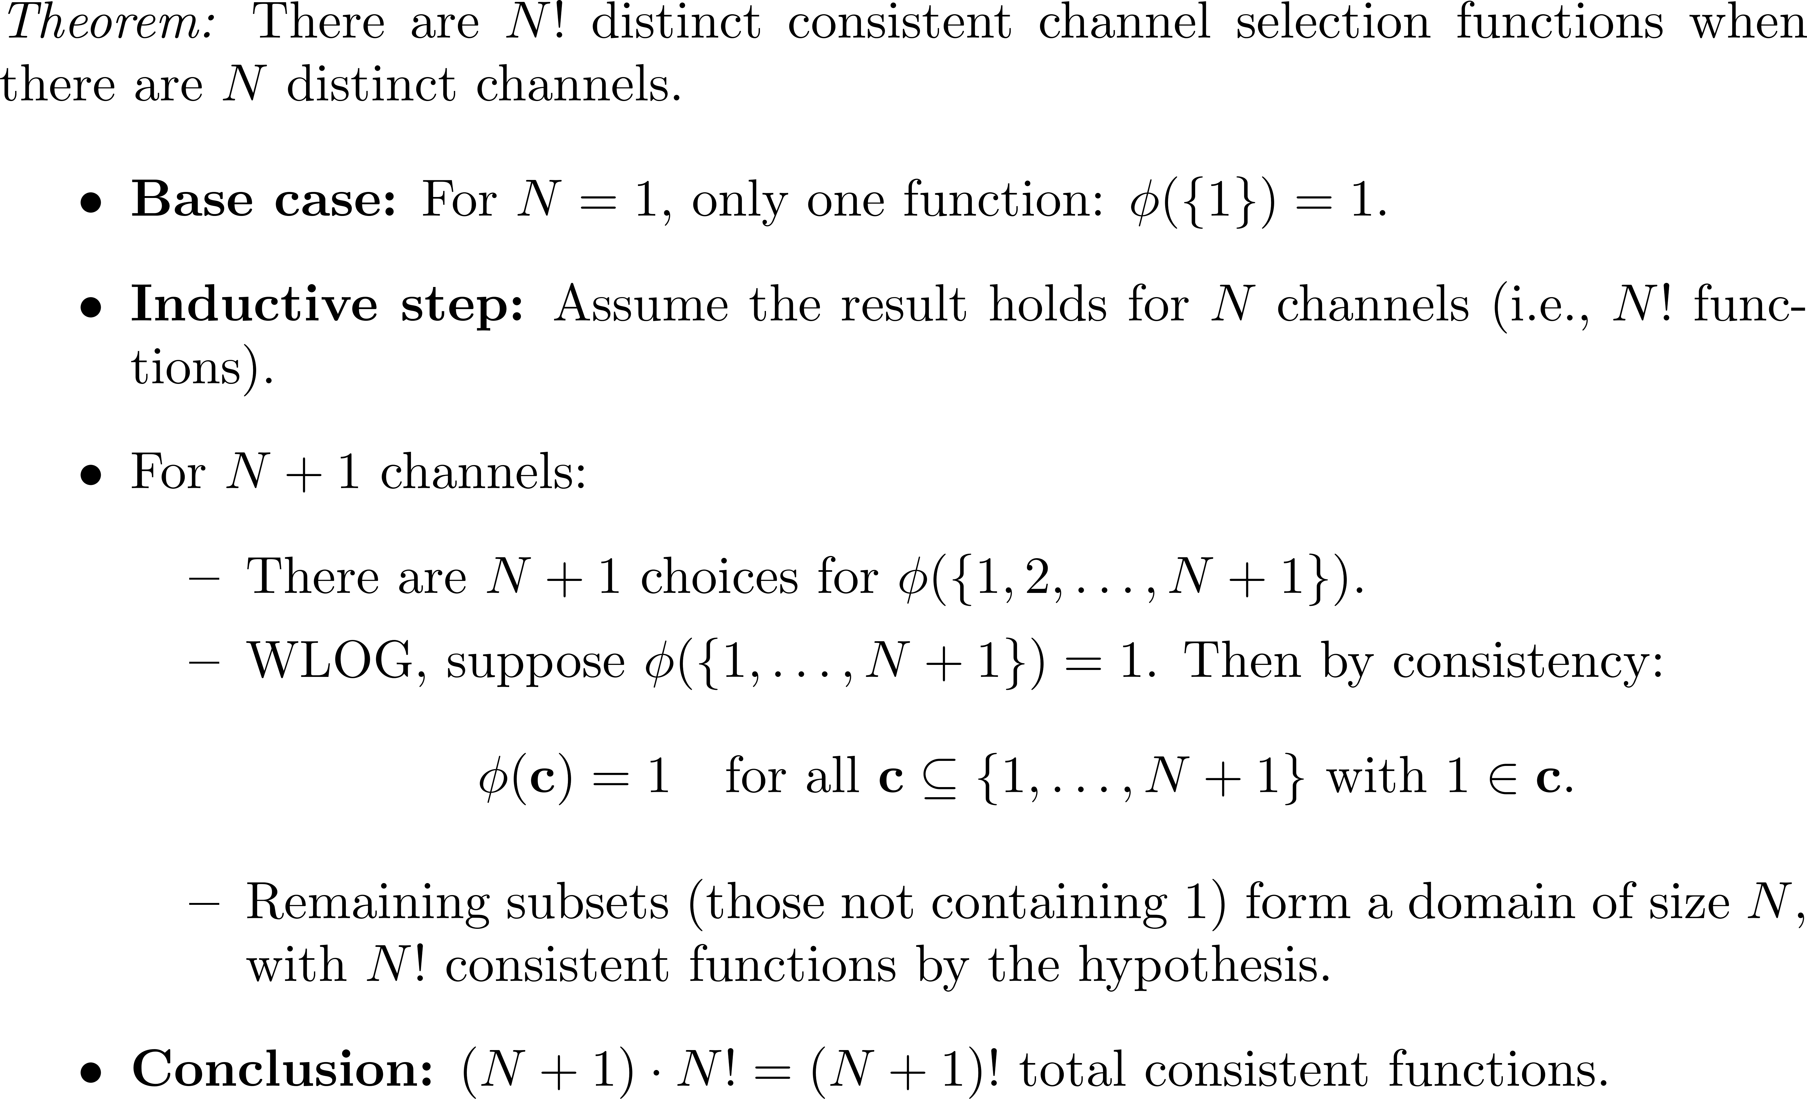
Number of Consistent Channel Selection Functions

Slide 9
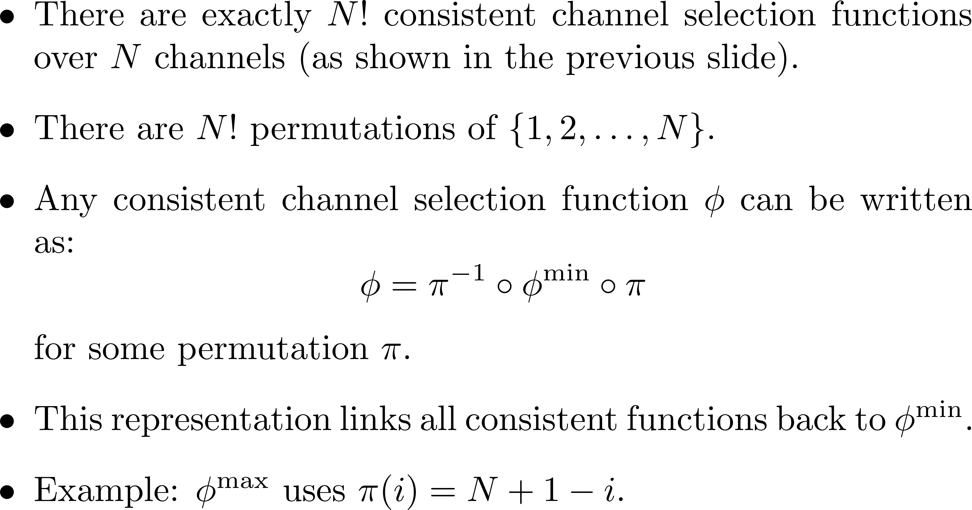
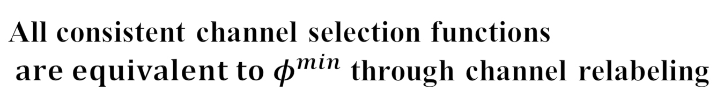
All consistent channel selection functions $are equivalent to φ^{min}$ through channel relabeling
9

Slide 10
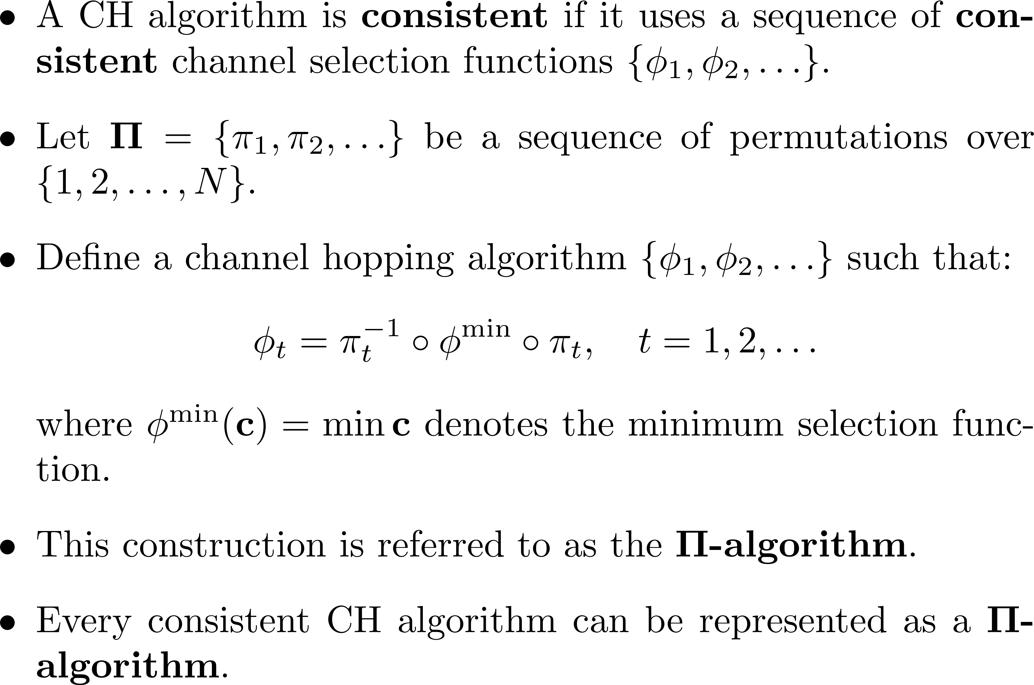
Consistent channel hopping algorithm
10

Slide 11
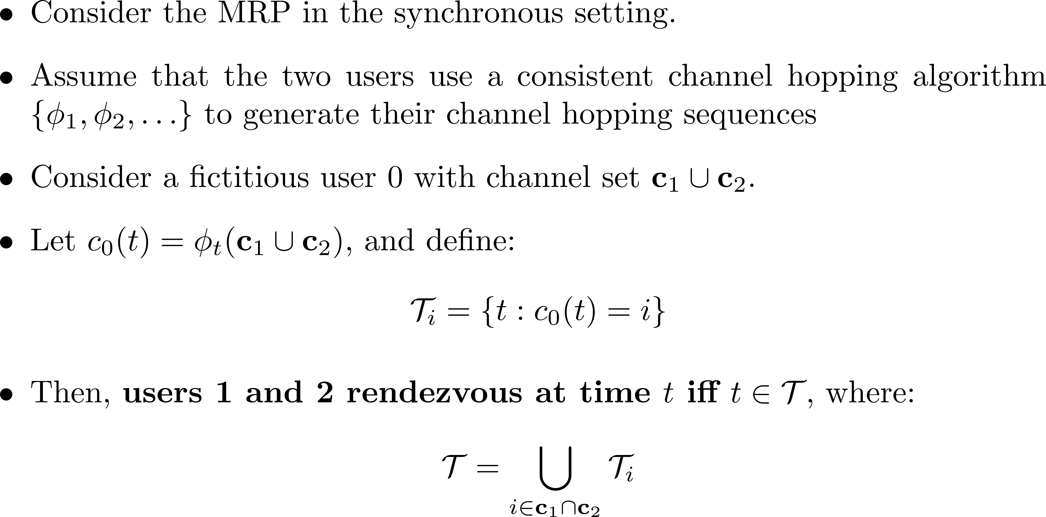
Characterization of the set of rendezvous time slots
11

Slide 12

Characterization of the set of rendezvous time slots
Fictious User (Union of the available channels of the two users)
User 1
User 2
$φt\left( \right)=c∈$
The channel selection of the fictious user is a common channel at time t.
↓
↑
Contradiction
↓
↑
Consistency
$$φt\left( \right)=φt\left( \right)=c∈$$
User 1 and User 2 rendezvous at time t.
12

Slide 13
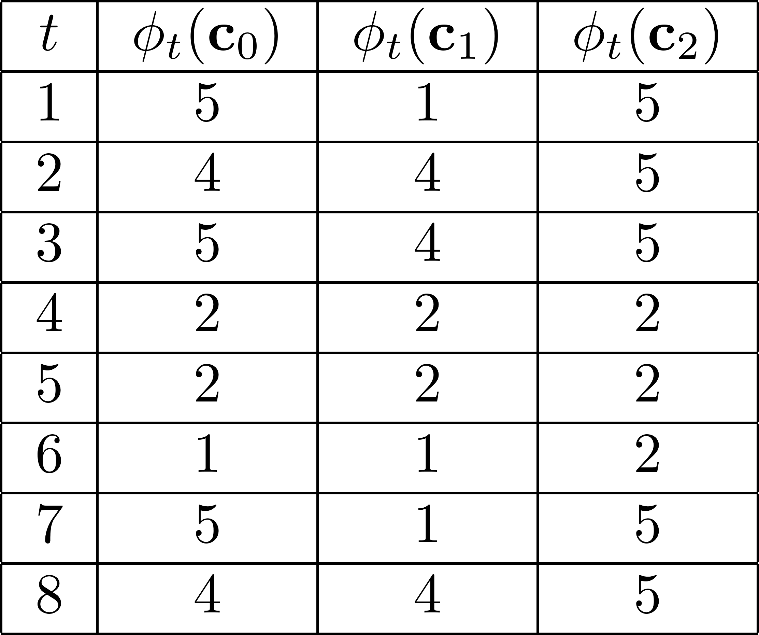
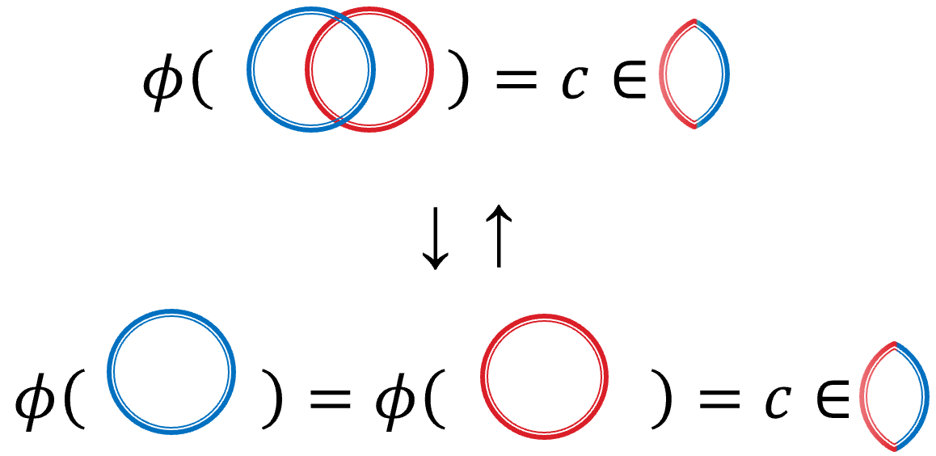
Characterization of the set of rendezvous time slots
13

Slide 14
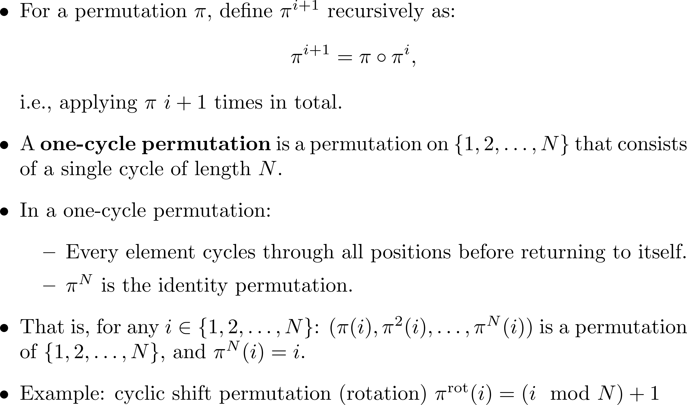
One-cycle permutation

Slide 15
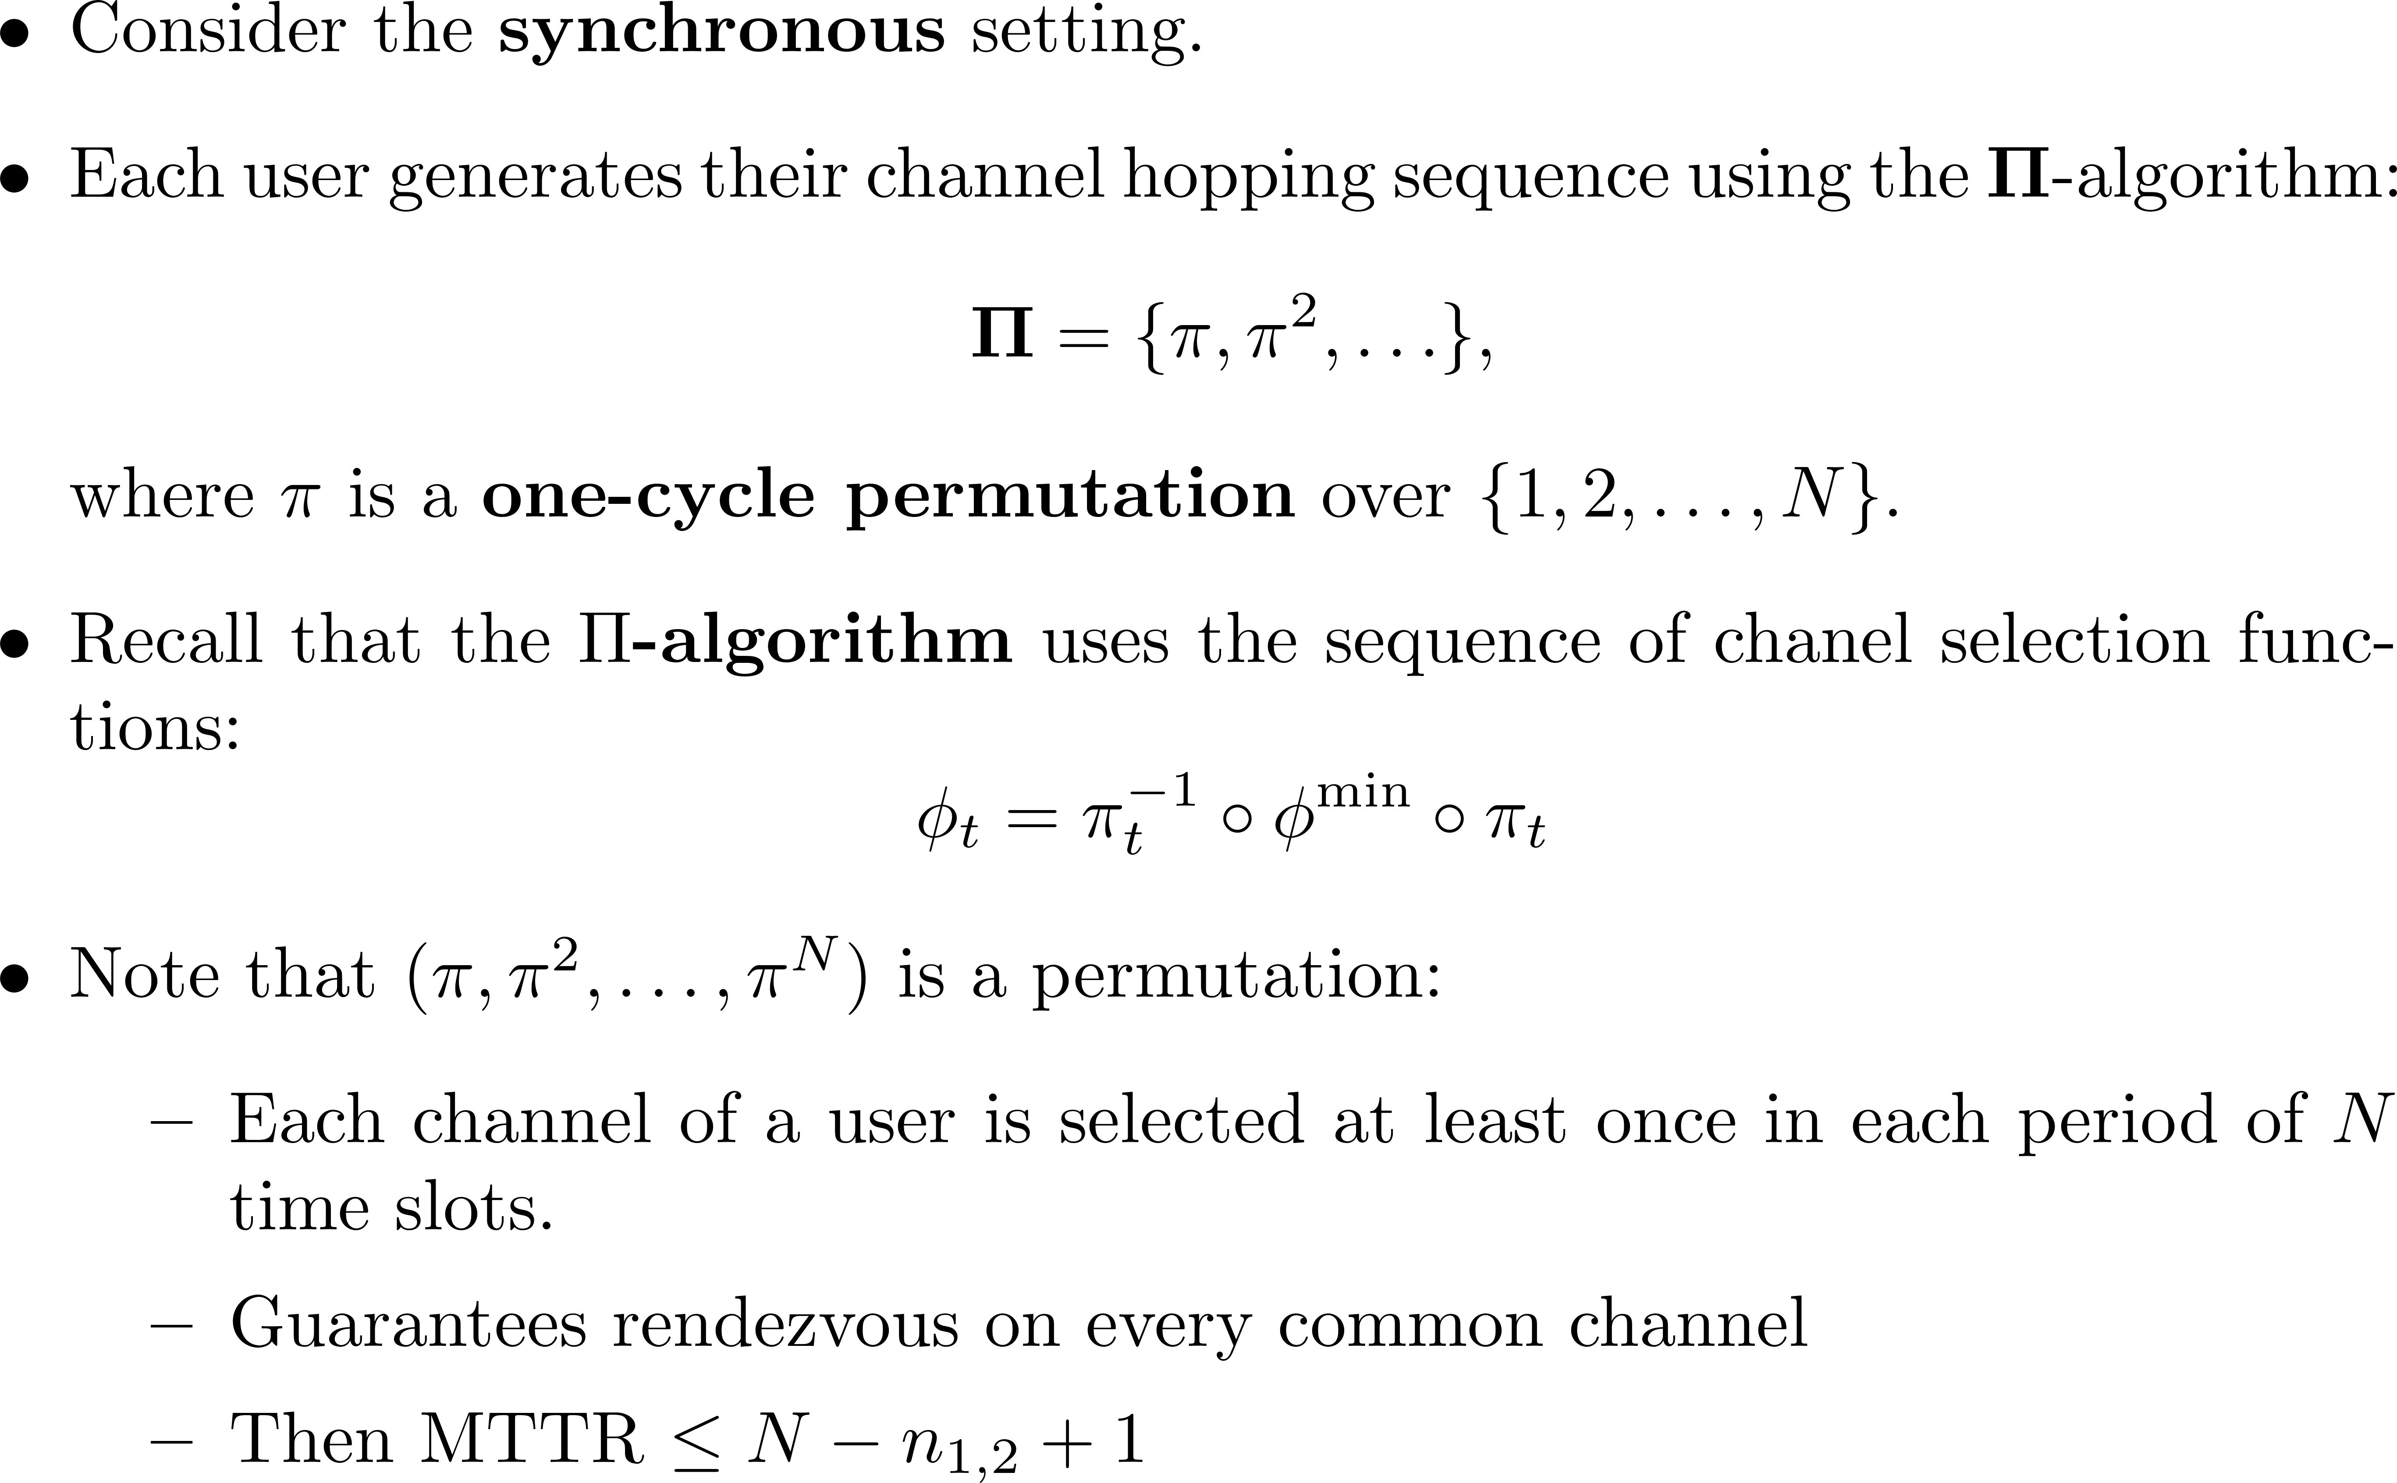
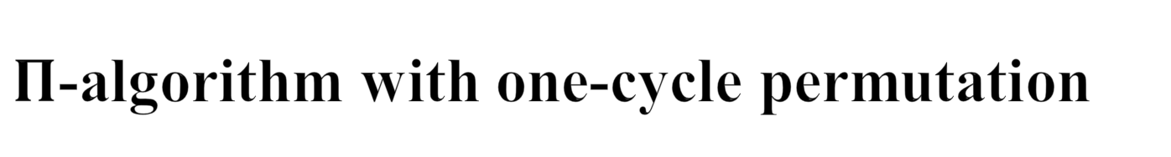
$Π$-algorithm with one-cycle permutation
Consider a fictious user with all the N channels
15

Slide 16
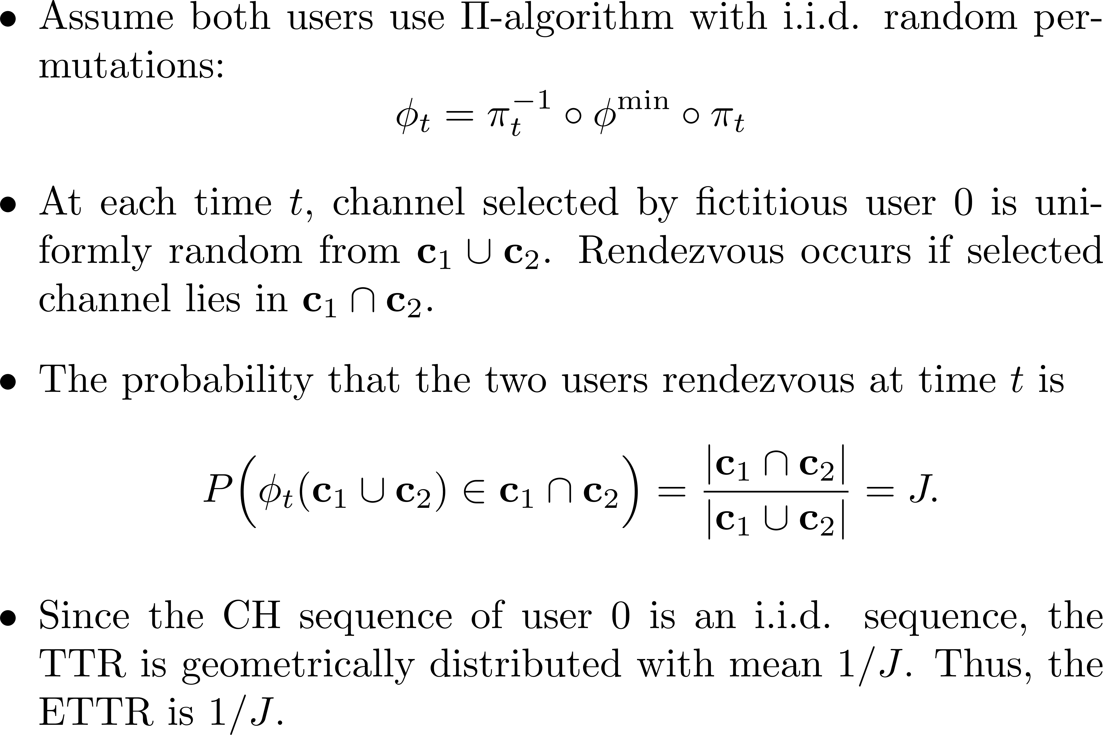


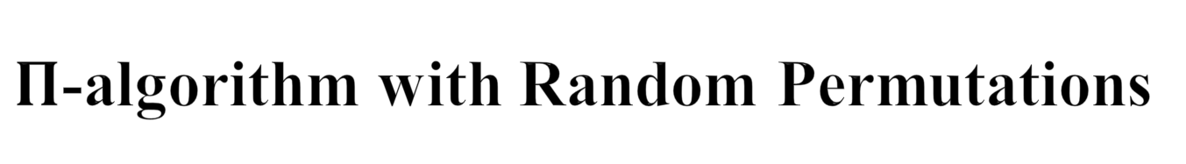
$Π$-algorithm with Random Permutations
16

Slide 17
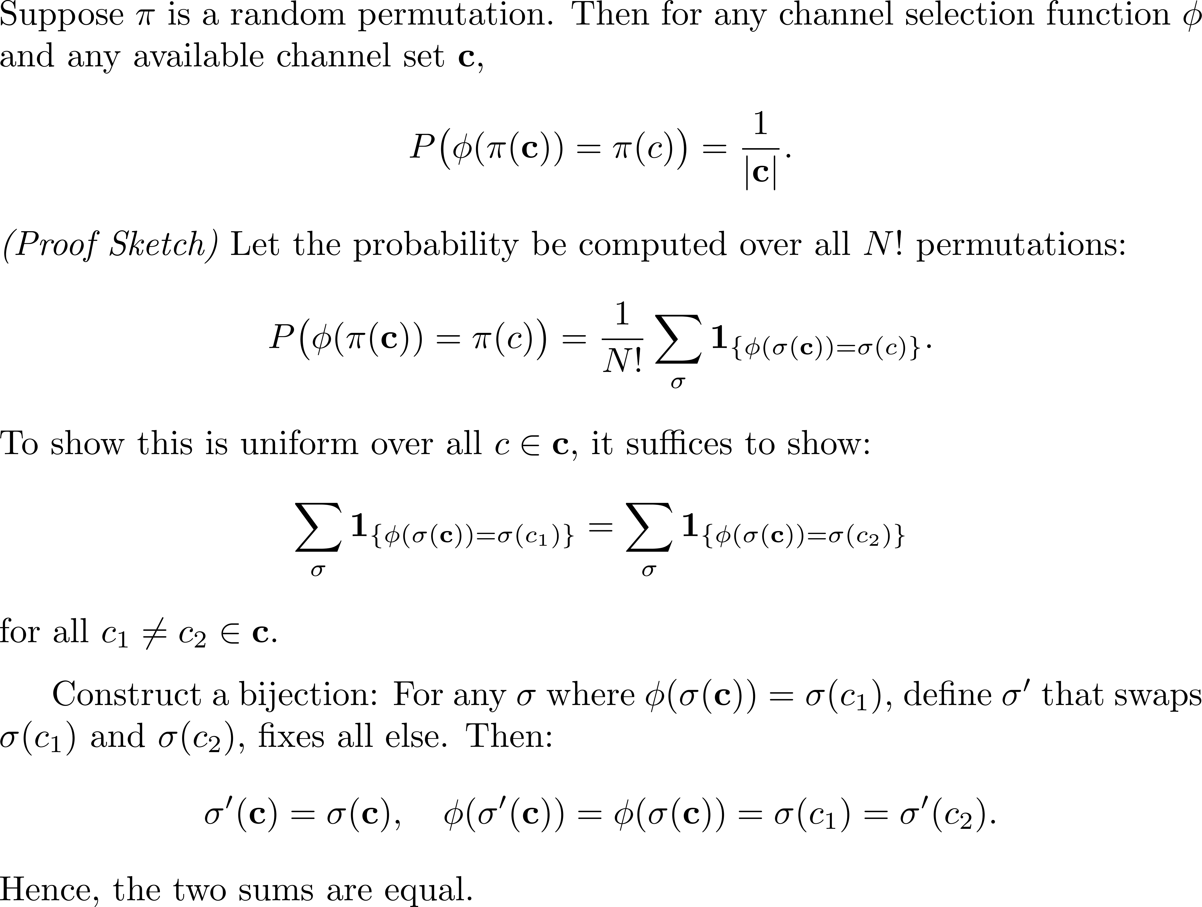
Fairness of Random Permutation-Based Selection

Slide 18
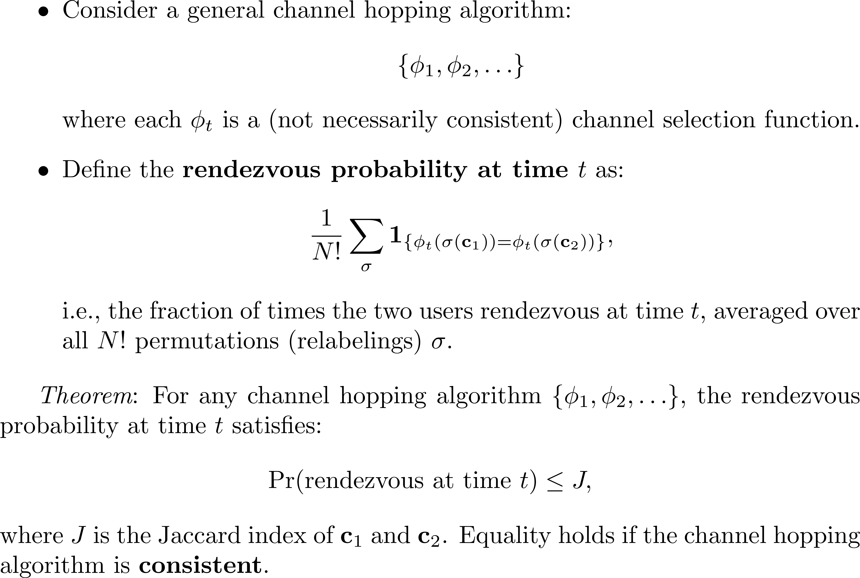
Optimality of Consistent CH Algorithms

Slide 19
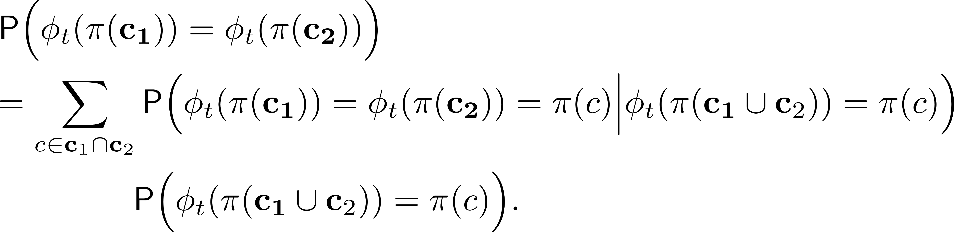
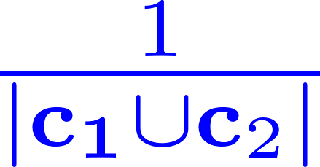
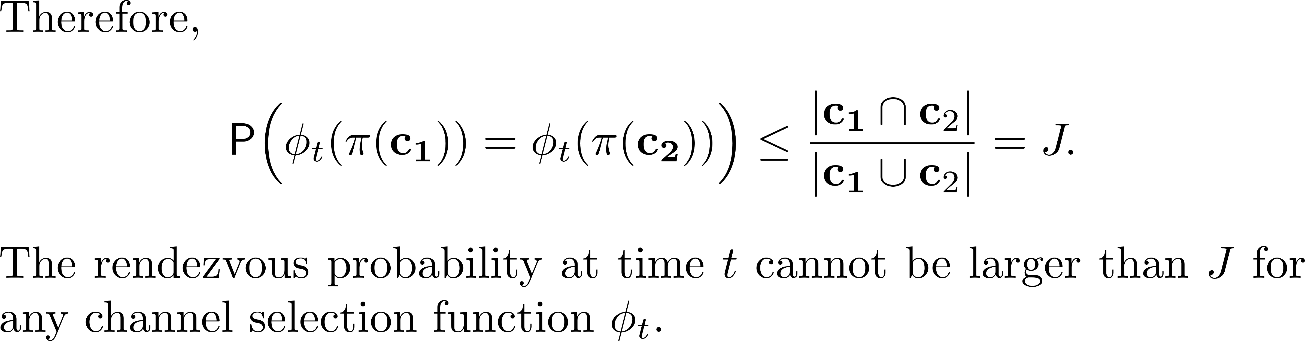

Optimality of Consistent CH Algorithms
The law of total probability
$$≤1$$
Fairness of channel selection of a random permutation
19

Slide 20
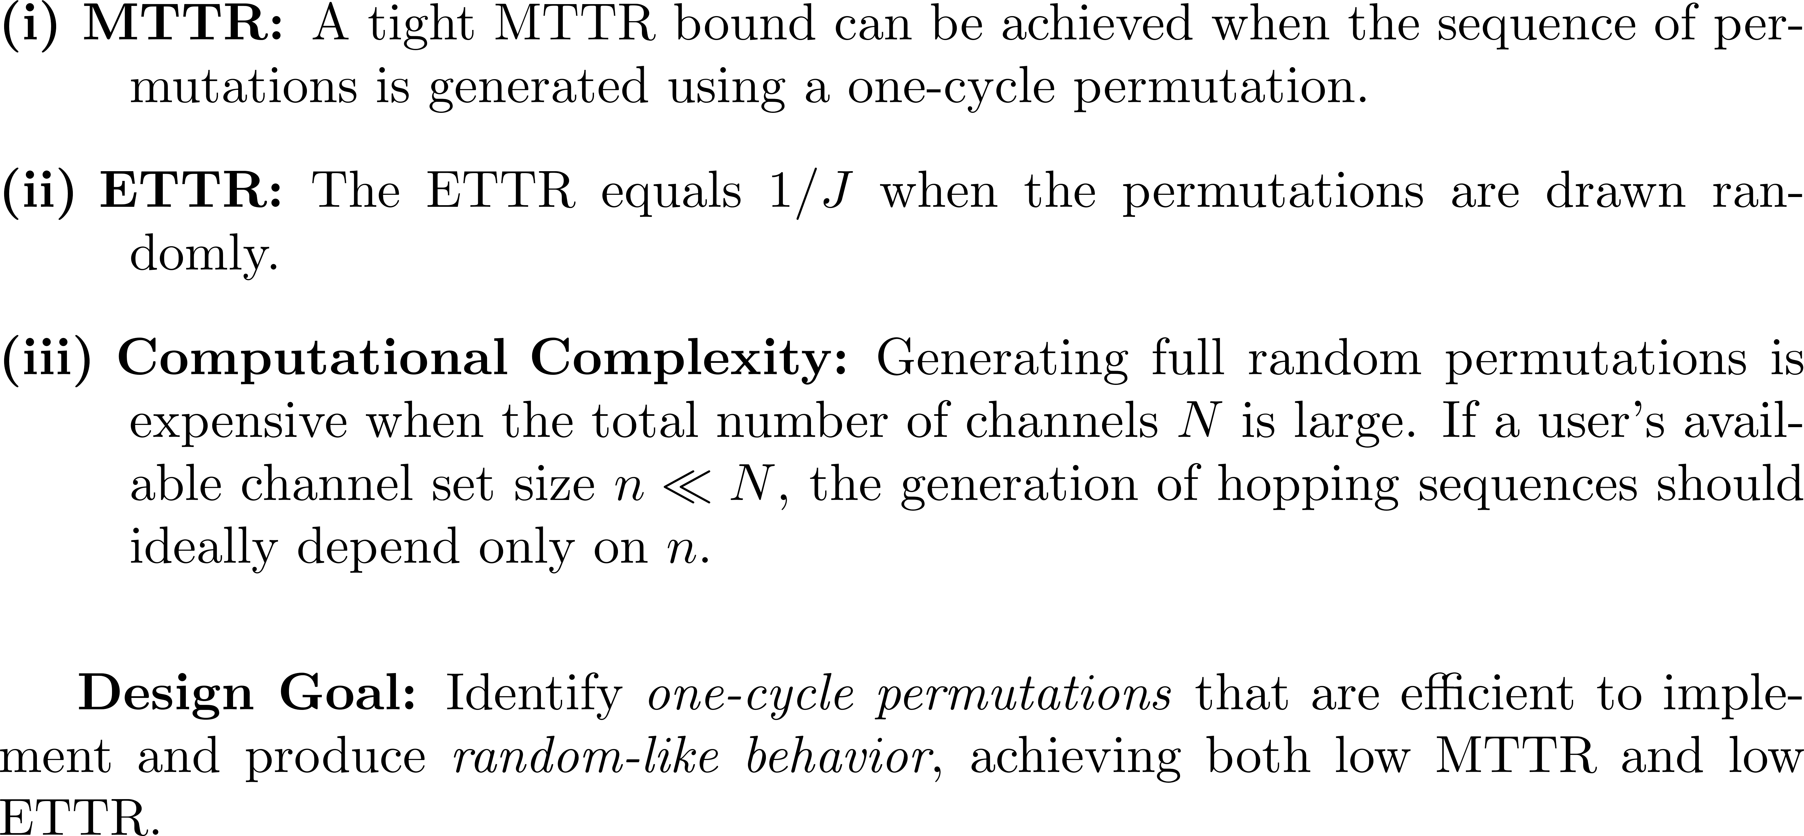
Design principles for the 𝚷-algorithm

Slide 21
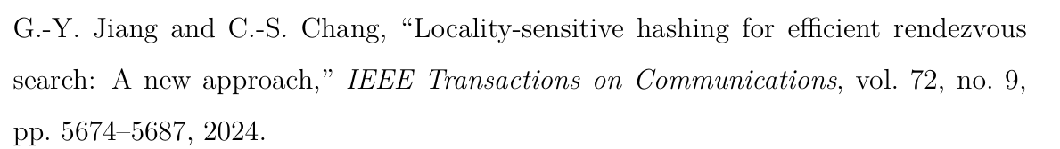
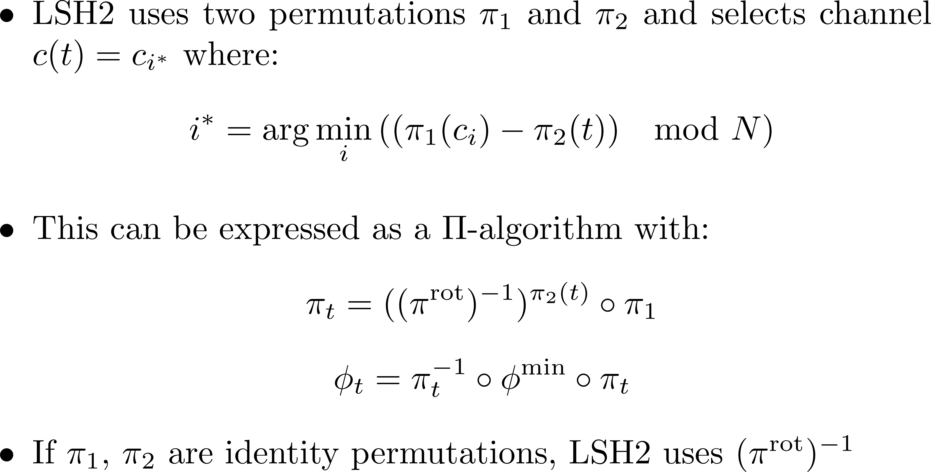
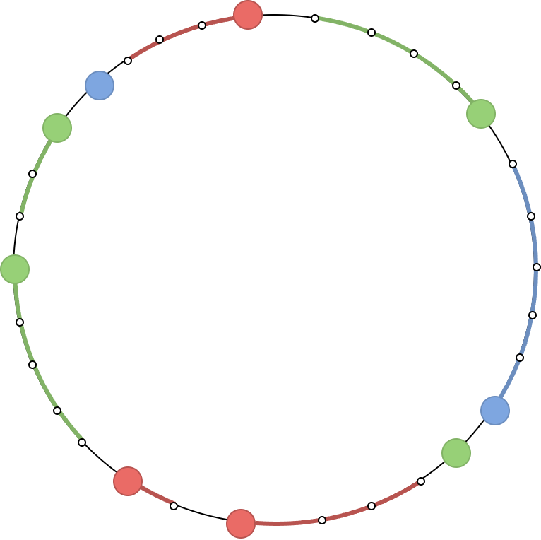




Implementation: LSH2
$$π_{2} (0)$$
$$π_{2}(1)$$
$$π_{2}(3)$$
$$π_{2}(2)$$
21

Slide 22
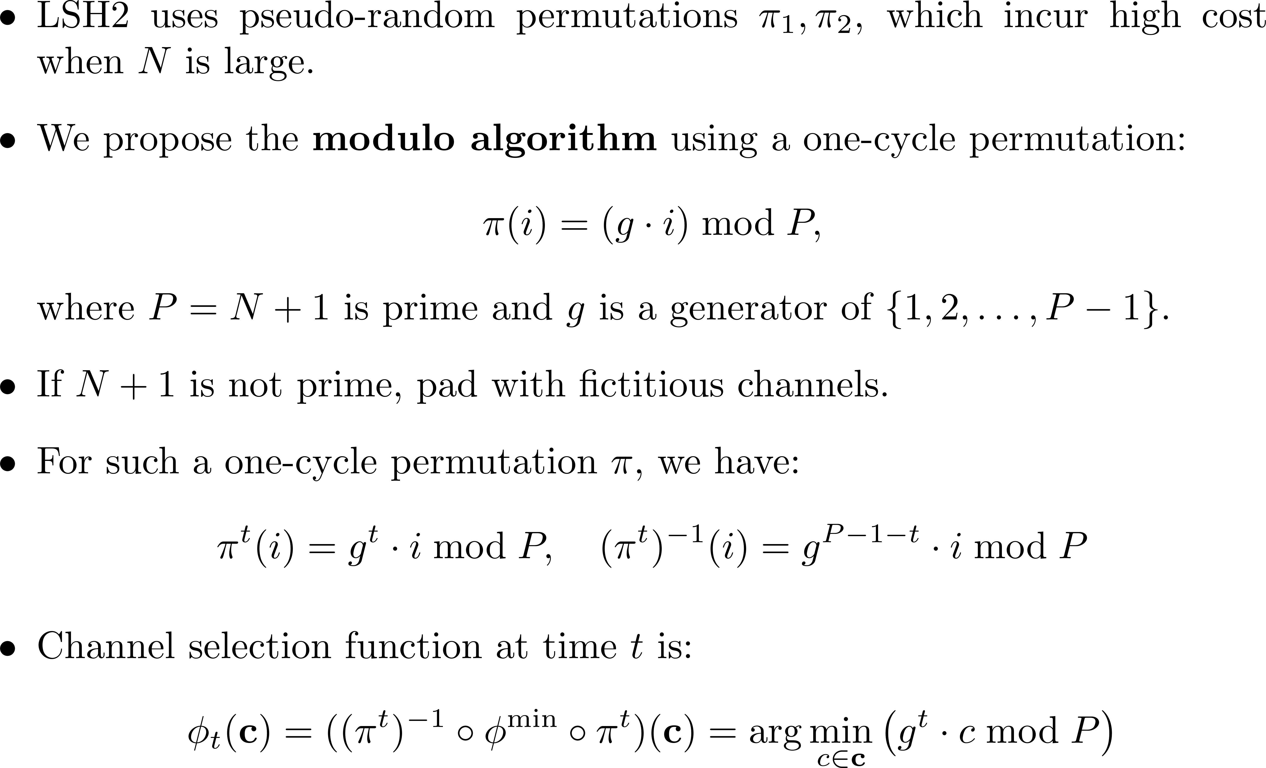
The modulo algorithm

Slide 23
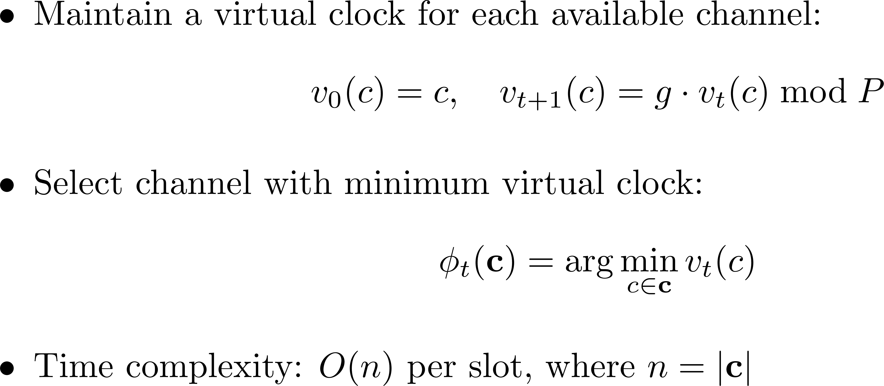
Virtual clocks: O(n) Time Complexity

Slide 24
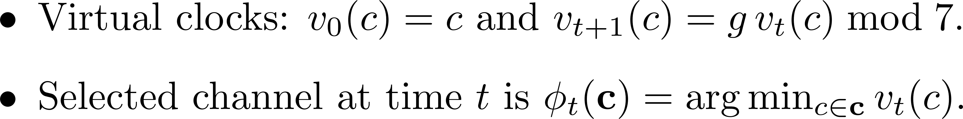
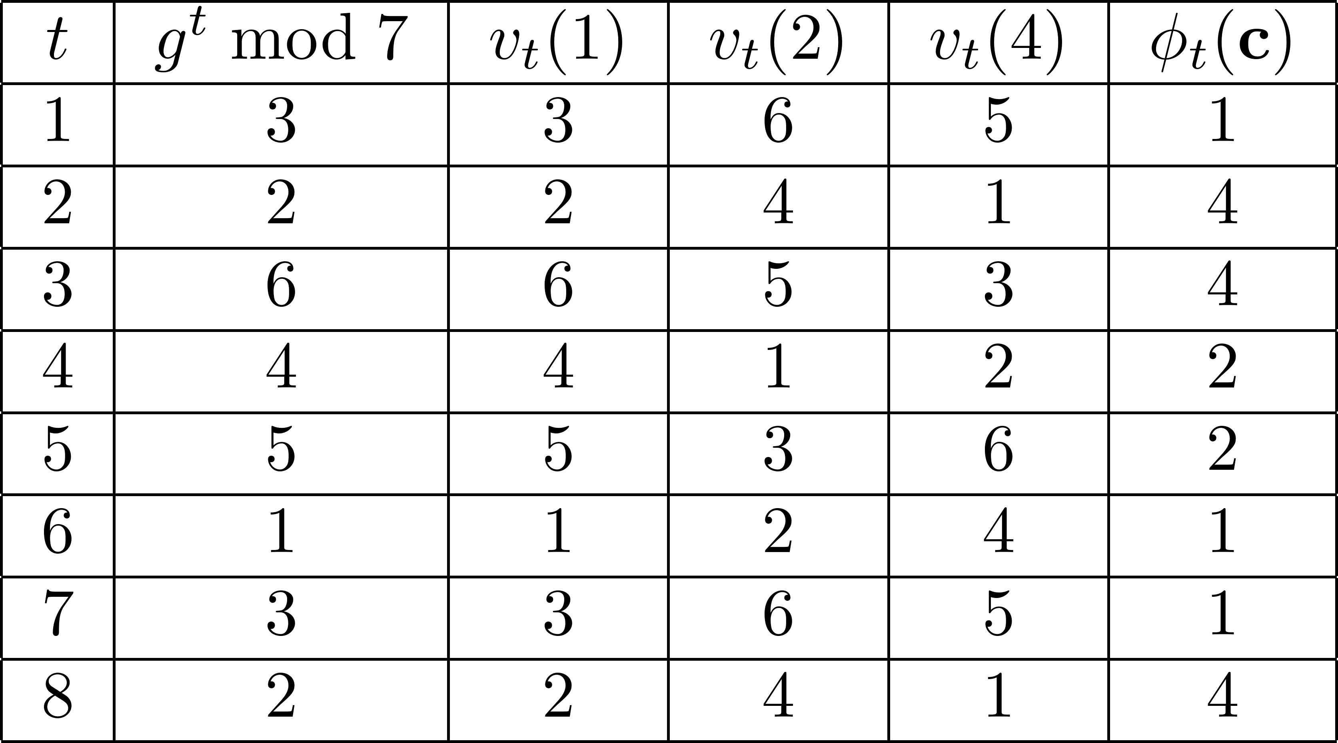

Slide 25
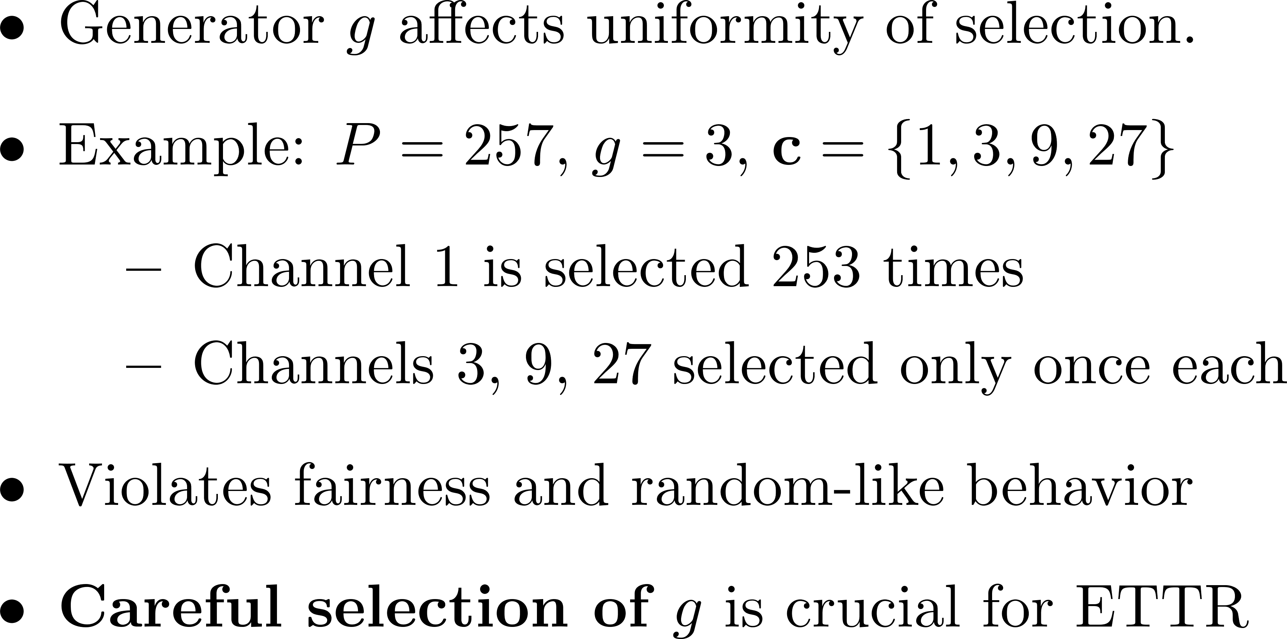
On the Choice of Generator

Slide 26
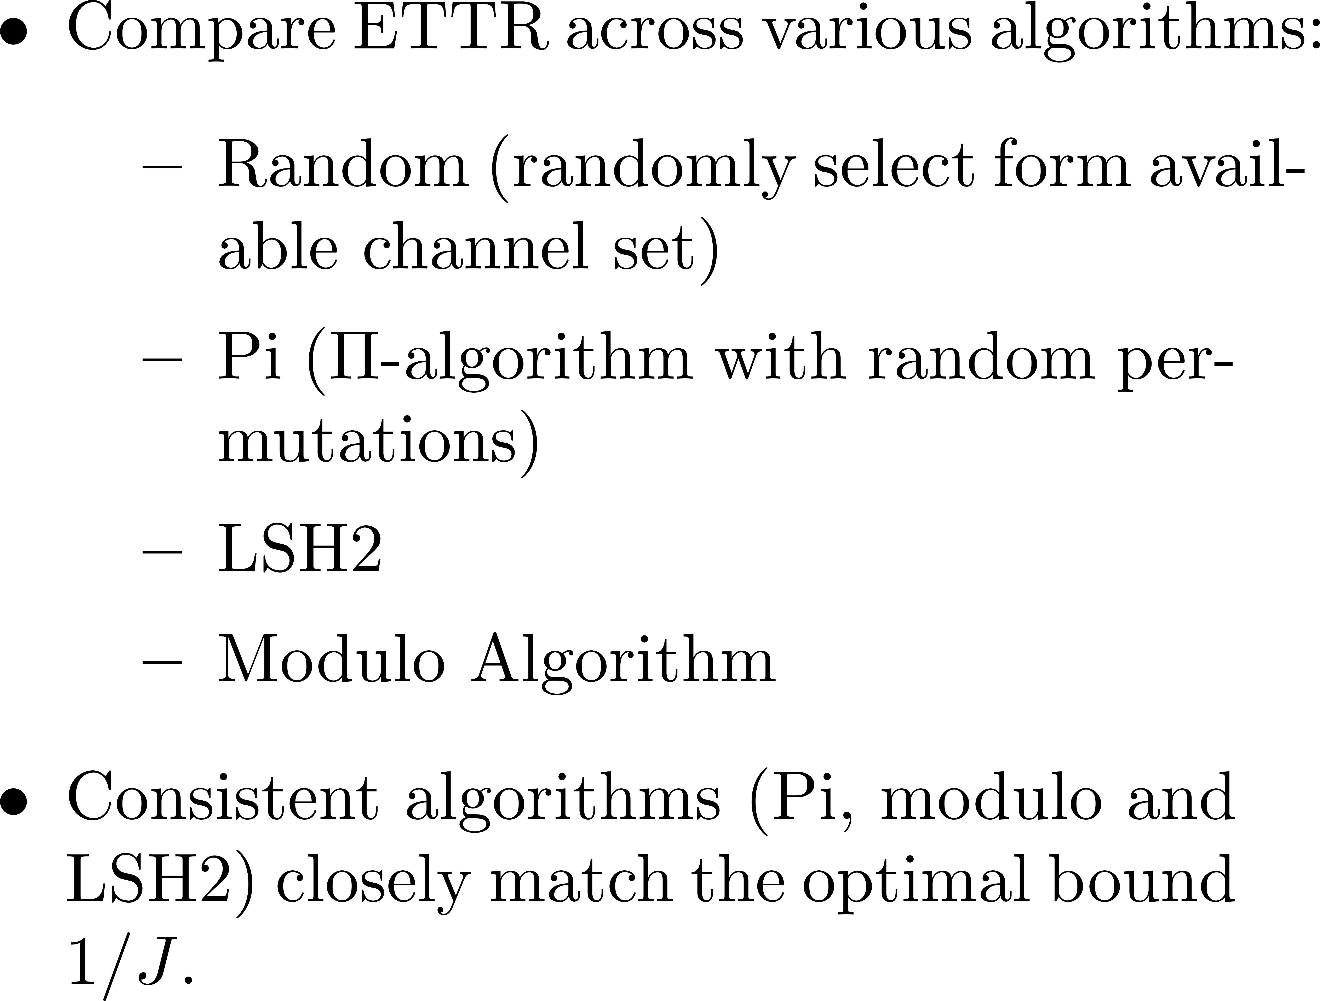

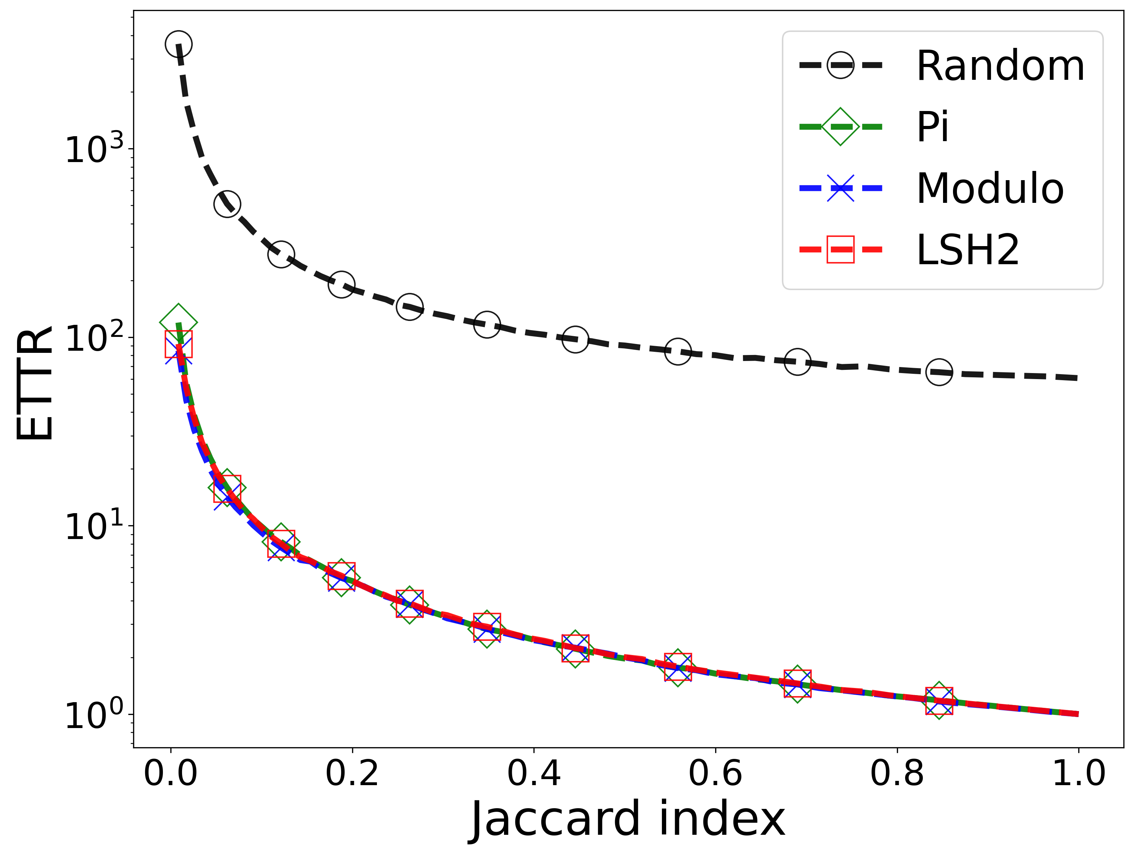
Simulation: 2 users in the synchronous setting (the sym/sync/hetero/global MRP)
26

Slide 27
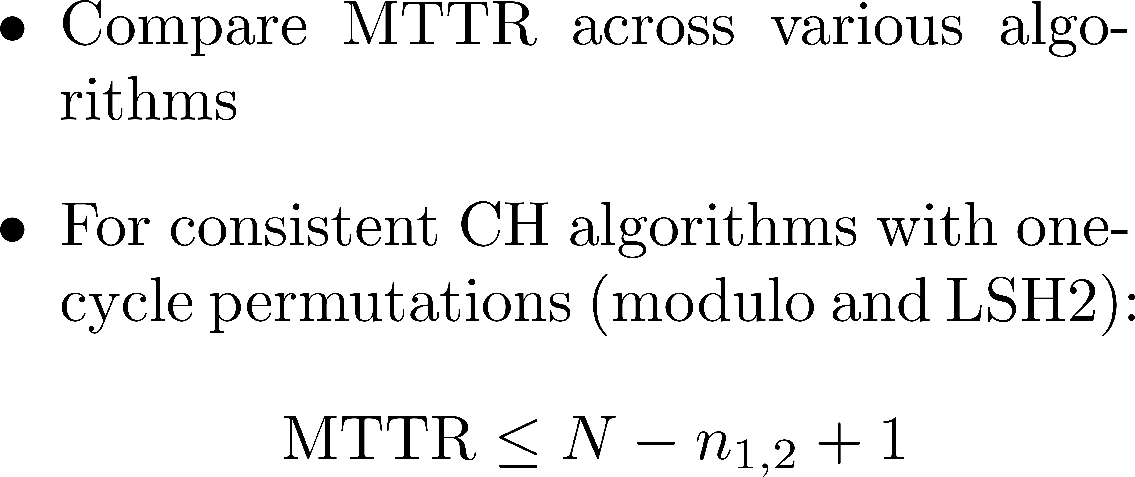
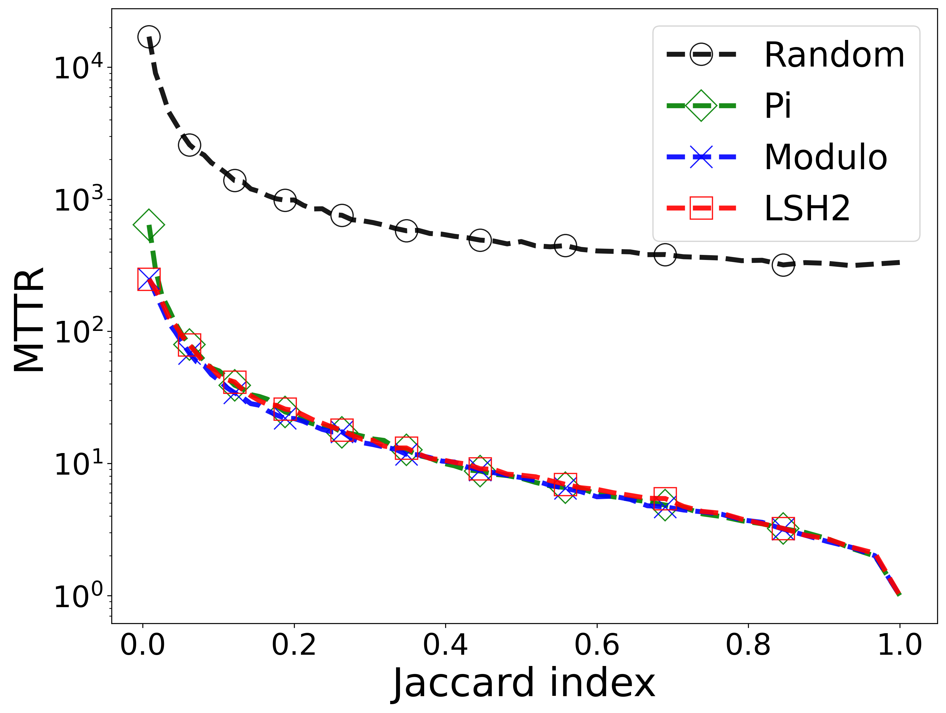
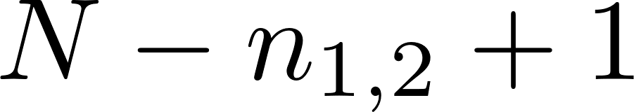
Simulation: 2 users in the synchronous setting (the sym/sync/hetero/global MRP)
27

Slide 28
Using a 𝚷-algorithm in the asynchronous setting
The sym/async/hetero/global MRP
The two users are indistinguishable.
Their clocks may not be synchronized.
Their available channel sets may differ
Each user's channel labels are globally labeled.

Slide 29
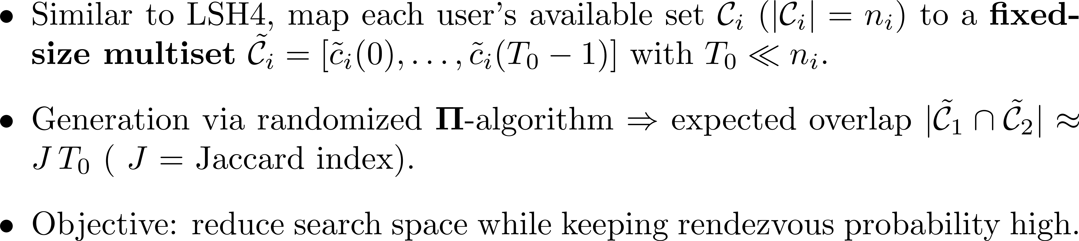
Dimensionality Reduction

Slide 30
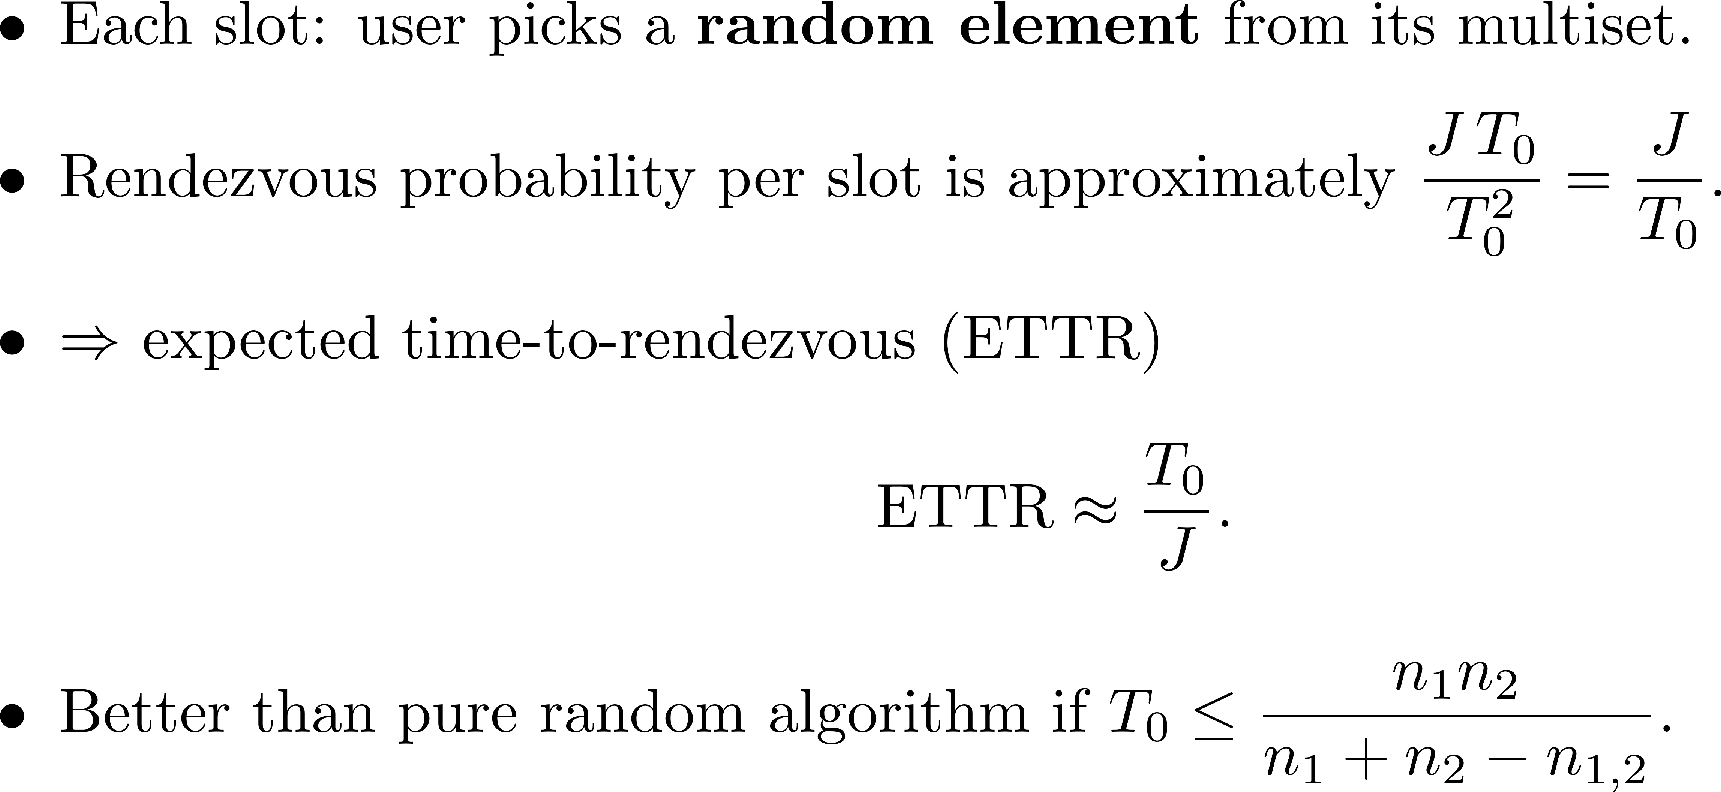
Random sampling from multisets

Slide 31
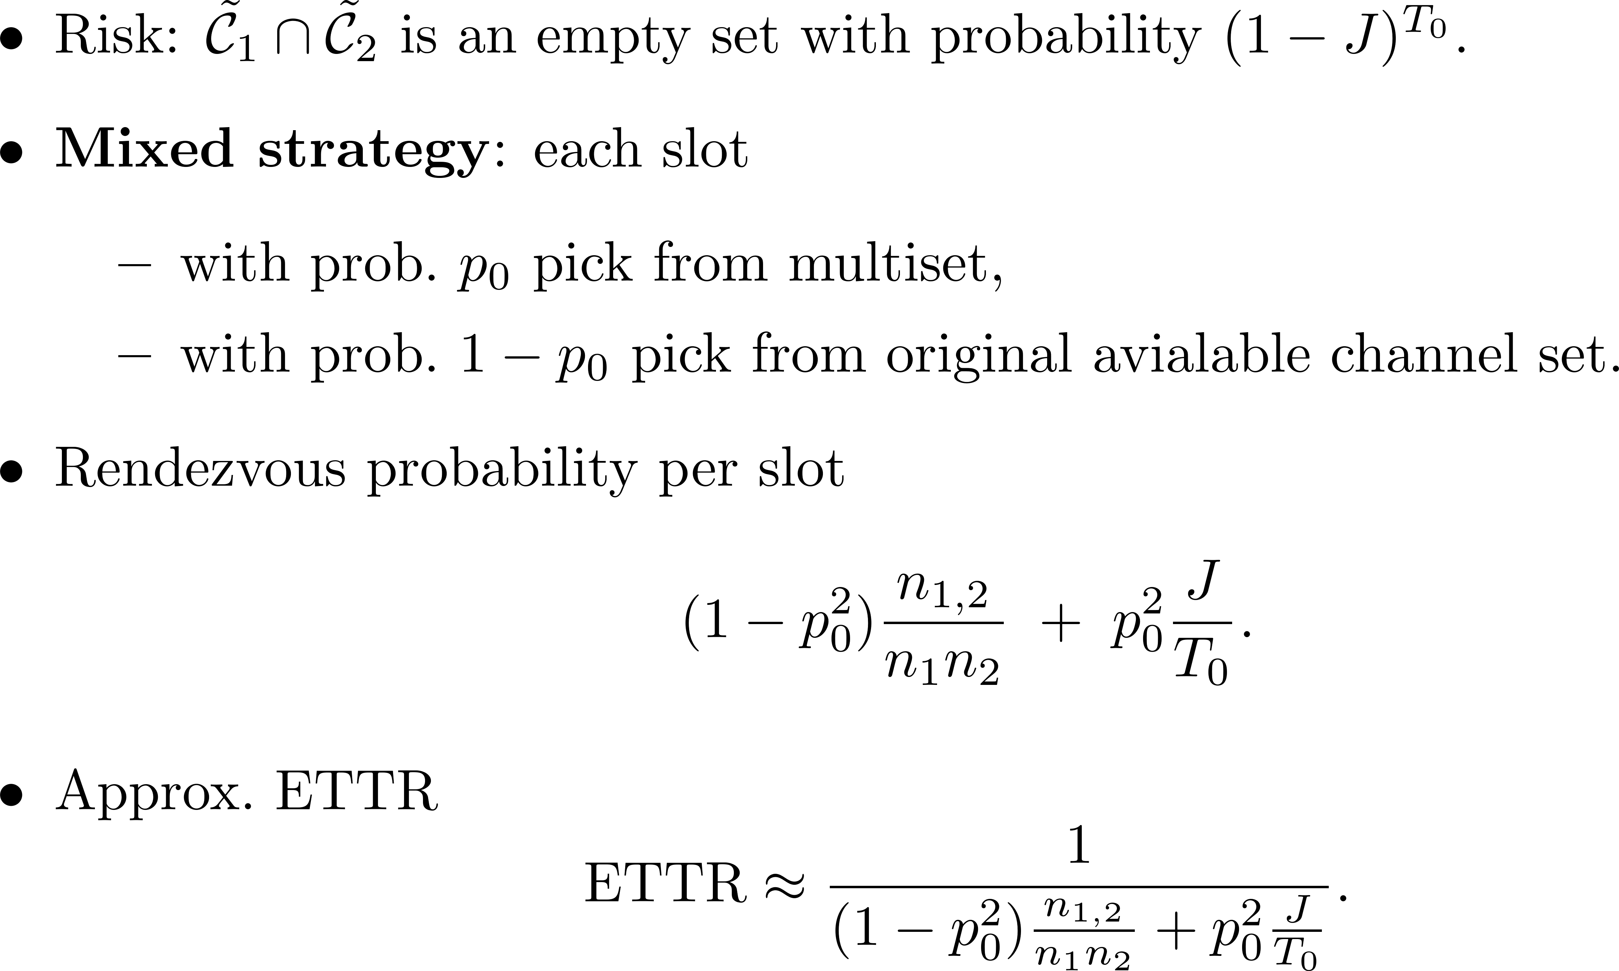
Mitigating Empty-Intersection Risk

